Slide 1
CODENERDS
DS
PROJECT NAME:- CAMPUS
-COMPASS
TEAM MEMBERS:-
ANUJ
ABHISHEK JHA
PREM
ABHISHEK
ANKIT
DESIGNATION
DEVLOPER
FRONT-END DEV
UI/UX
BACK-END DEV
AI EXPERT

Slide 2



CAMPUS-COMPASS
project statement
Campus Compass helps you streamline reporting and intelligently matches items.
PROJECT STATEMENT
Lost items in campuses/events are very common.
Current systems = manual logs,
Notice boards → slow & unreliable.
Students waste time & effort, items remain unclaimed.
No transparency / trust in existing Lost & Found.
Why AI?
The AI-powered system addresses these inefficiencies by offering a frictionless, data-driven, and engaging experiencefor modern consumers.

Slide 3

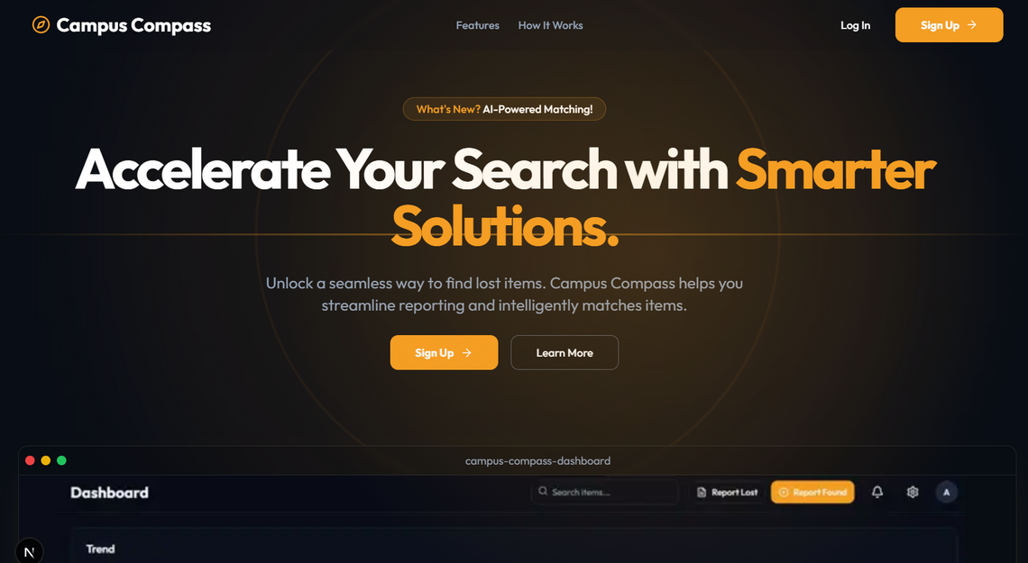
PROPOSED SOLUTION
proposed
solution
AI-powered web app to smartly connect lost & found items.
Multimodal AI (Gemini API) uses image + text embeddings for accurate matching.
Secure locker system ensures trusted & transparent item storage.
Gamified points & rewards motivate students to return items honestly.
Scalable solution that can expand from campuses to airports, malls, and events.
How It Works?
Students (users) report lost or found items via web app, mobile app, or campus kiosks.
AI suggests possible matches based on uploaded photos and descriptions.
The system assigns a Locker ID and securely logs the item for easy retrieval.
Students receive real-time match notifications & claim status updates.
AI improves over time by learning from successful matches and feedback.

Slide 4

OBJECTIVES & GOALS
Objective & Goals
Simplify & speed up item recovery in campuses/events.
Ensure trust & transparency.
Motivate students via gamified rewards.
Long-term: scale to airports, malls, transport hubs.
15-20%
30%
50%
Increase in successful item recovery
Growth in student engagement with the app
Faster matching & claiming process compared to manual systems

Slide 5






Technology Stack
FLOWCHART
FRONTEND
AI INTEGRATION
BACKEND

Slide 6



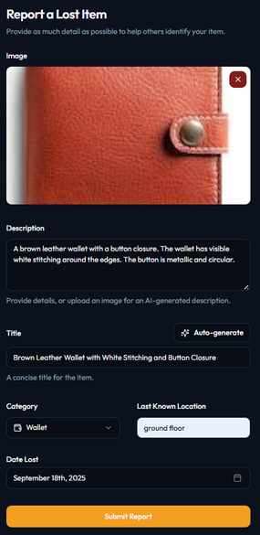
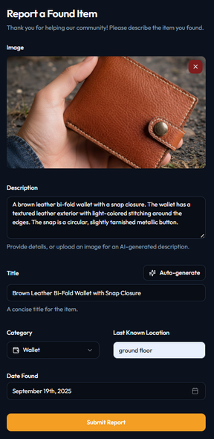
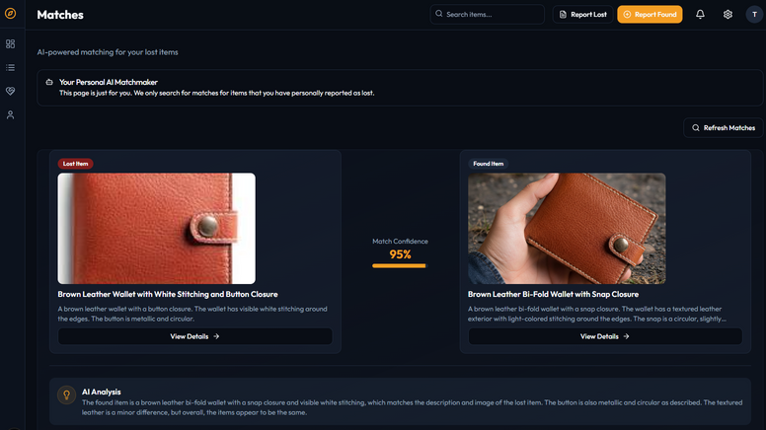
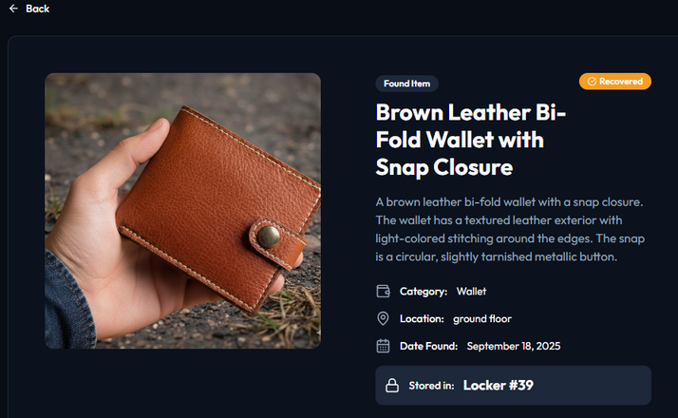
System Architecture
User uploads lost/found item
(photo + description + details )
AI → generates embedding → stored in Supabase.
Lost item query → Locker Room Allowed
Workflow
Upload Item (photo + description) → AI Embedding (Gemini) → Store in Supabase →
Match Lost & Found → Assign Locker ID → Claim & Verify → Points Awarded

Slide 7

Key Features & Innovation
AI-Powered Matching → Image + text similarity using Gemini for accurate results.
Locker ID Assignment → Secure storage to avoid mix-ups & fraud.
Gamification → Points & rewards system to encourage honesty.
Admin Dashboard → Easy dispute handling & claim verification.
Scalability → Expandable from campuses to airports, malls & events.

Slide 8

Implementation Plan
Phase 1
IDEATION & DESIGN
DEFINE PROBLEM SCOPE, CREATE WIREFRAMES, AND FINALIZE TECH STACK.
Phase 2
DEVELOPMENT
SET UP SUPABASE - INTEGRATE GEMINI API -
BUILD FRONTEND WITH NEXT.JS + TAILWIND
Phase 3
TESTING & PILOT
CAMPUS PILOT: TEST AI ACCURACY ON 10-20 LOST/FOUND ITEMS AND REFINE WORKFLOW BASED ON FEEDBACK.
Phase 4
DEPLOYMENT & SCALING
CAMPUS ROLLOUT WITH LOCKERS AND GAMIFICATION, THEN SCALE TO MALLS, EVENTS, AND TRANSPORT HUBS.

Slide 9

Challenges → Risk Management
→
AI mismatches
Data privacy
User adoption
Scalability
Show similarity score + admin approval.
Only store images + descriptions (no
personal data).
Encourage via gamified rewards.
Supabase cloud-native backend.
→
→
→
“Only those who will risk going too far can possibly find out how far it is possible to go."
— T.S. Eliot

Slide 10


HOW WE WILL TRACK SUCCESS
Impact & Conclusion
Metric | Target
Impact | Saves time, reduces chaos, builds trust.
Value | Encourages honesty & responsibility.
Scalability | Campus → Airports → Events → Smart Cities.
Conclusion | Smart, AI-driven, and future-ready Lost & Found system.
Revenue Model
Subscription for universities & events.
Pay-per-use for airports and malls.
Sponsored lockers & corporate partnerships.

